Slide 1

Protein Structure Prediction
Using Deep Learning
Prepared by:
Pradip Sapkota ACE076BCT058
Shishir Bastola ACE076BCT080
Shree Krishna Shrestha ACE076BCT081
Sonu G.C ACE076BCT085
Under The Supervision of : Er. Dhiraj Pyakurel

Slide 2
OVERVIEW
Introduction
Problem Statement
Project Objective
Literature Review
System Requirements
Methodology
Epilogue
Analysis and Conclusion

Slide 3
INTRODUCTION
Protein structure prediction is a computational technique used to predict the structure of a protein based on its amino acid sequence.
Protein structure prediction is an active area of research, and ongoing efforts aim to enhance prediction accuracy and expand its applications.
The structure of a protein determines its function, and predicting this structure is challenging due to the vast number of possible conformations.

Slide 4
PROBLEM STATEMENT
The accurate prediction of protein structure remains a challenging task, despite numerous attempts in the field.
The complexity arises from the fact that proteins are composed of 20 different amino acids, and the possible combinations and resulting shapes are vast, numbering in the trillions.

Slide 5
PROJECT OBJECTIVE
To develop a deep learning model for accurate Protein Structure Prediction.

Slide 6
Significance of the Study
Accurate protein structure prediction is crucial for understanding protein function and designing effective drugs.
Computational methods, such as deep learning models, offer a faster and more accessible approach to predict protein structures compared to experimental techniques.
The development of a successful deep learning model for protein structure prediction can have broad implications for bioinformatics and molecular biology research.

Slide 7
SYSTEM REQUIREMENTS
Software Requirements
Python
Colab
Tensorflow
Bioinformatics Libraries
Pytorch
Hardware Requirements
GPU
Storage

Slide 8
LITERATURE REVIEW
Title of Paper | Author(s) | Year | Key Findings
”Improved protein structure prediction using potentials from deep learning.” | Senior et al. | 2020 | Introduced Alpha Fold, an attention based deep learning model that combines a novel residual neural network architecture with a distance based potential function.
”TCN-based Prediction of Protein Secondary Structure” | Smith et al. | 2019 | TCN demonstrated competitive accuracy in predicting secondary structures, excelling in capturing long-range dependencies on ProteinDB.
”Hybrid Model for Protein Secondary Structure Prediction: RNN and GNN Fusion” | Lee et al. | 2021 | Proposed a hybrid model combining RNN and GNN, showcasing synergistic effects and achieving a balance between local and global structure information.

Slide 9
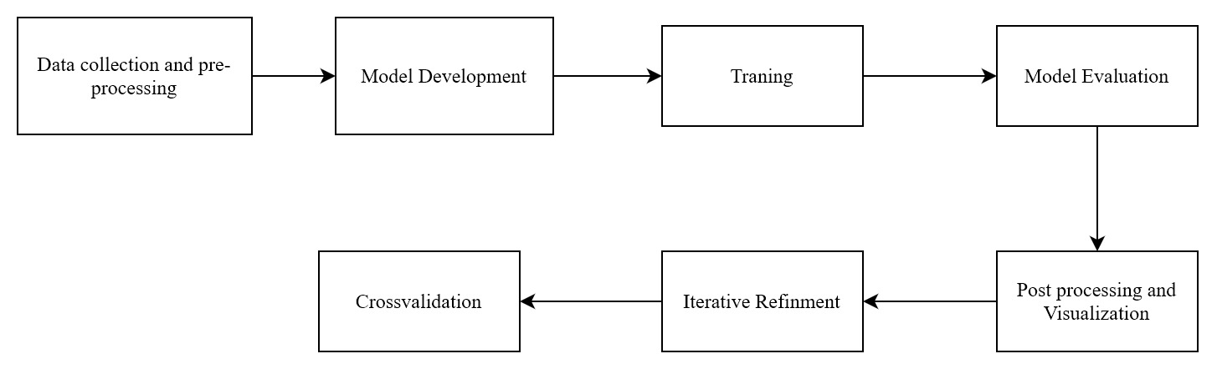
METHODOLOGY
.
Fig System Design

Slide 10
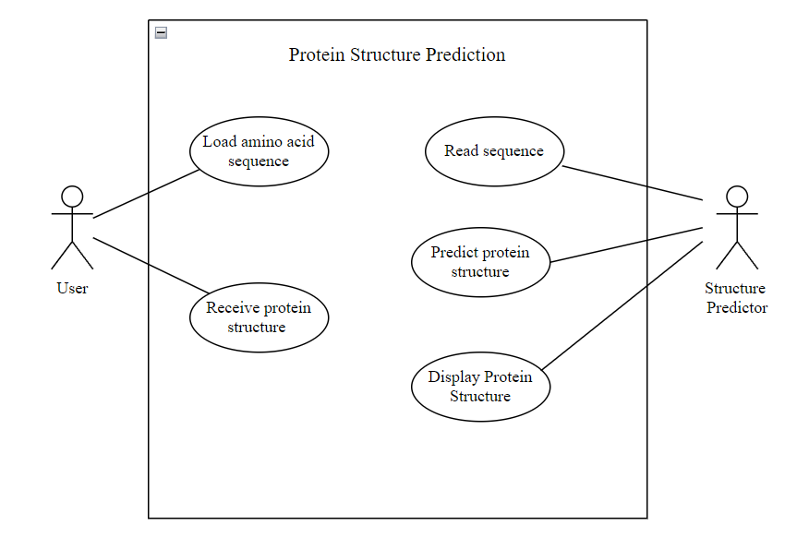
METHODOLOGY
Fig :Use Case Diagram

Slide 11
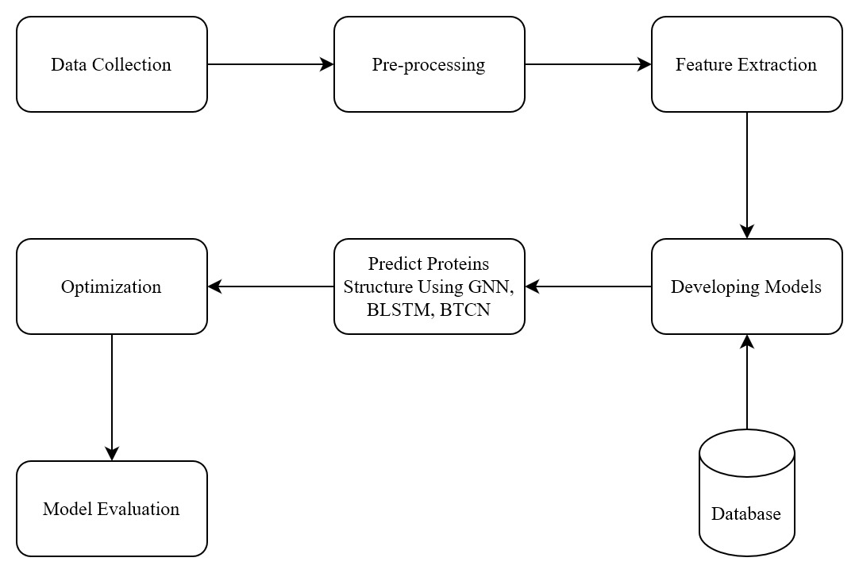
METHODOLOGY
Fig : System Architecture

Slide 12
Epilogue
Work completed
Research
Data Collection
Data Preprocessing
Visualization
Data Split
Model Development

Slide 13
Work remaining
Model Development
Model Training
Model Evaluation
Hyperparameter Tuning
Model Testing
Performance Analysis
Deployment

Slide 14
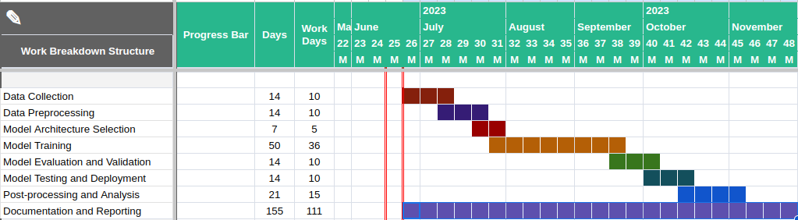
Time Schedule

Slide 15
REFERENCES
[1] Hartmanis, M. (2019). Protein Structure and Function. In Biochemistry (pp.932).Springer.
[2] Alberts, B., Johnson, A., Lewis, J., Raff, M., Roberts, K., & Walter, P. (2002).
Proteins. In Molecular Biology of the Cell (4th edition). Garland Science.
[3] Baldi, Pierre, and Gianluca Pollastri. "The principled design of large-scale
recursive neural network architectures--dag-rnns and the protein structure
prediction problem." The Journal of Machine Learning Research 4 (2003):
575-602.

Slide 16
Thank You!!!

